Slide 1
CRASH COURSE IN STATS
What is a normal distribution?
What are the ways we can characterize a data distribution?
Location (median, mean)
Spread (IQR, standard deviation)
Symmetry (skewness coefficient, Yule-Kendall index)
How can we meaningfully visualize a distribution?
Box-and-whisker plots
Histogram
Scatter plots

Slide 2
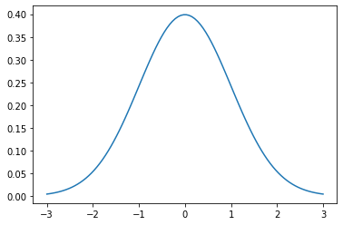
STATISTICAL DISTRIBUTIONS
Standard normal distribution:
µ = 0, σ = 1
Normal distribution: a symmetric distribution of data that takes on a bell-shape, with the mean value = median value (at the center) and with
68.2% of data within 1σ
68.2% of data within 1σ
95.5% of data within 2σ
99.7% of data within 3σ

Slide 3
MANY STATISTICAL ANALYSES ASSUME YOUR DATA HAS A ~ NORMAL DISTRIBUTION!!!

Slide 4
KEY CONSIDERATION FOR STATISTICAL TOOLS
Best to use statistical tools that are robust (works on a variety of data, without a lot of assumptions) and resistant (not very sensitive to outliers)

Slide 5
BASIC STATISTICAL CHARACTERISTICS: LOCATION
Location: center of the data
Median: half of data is above, half is below: 50th percentile
Mean is a useful measure, but can be really skewed by outliers
Other useful quartiles: Q1 (25th percentile), Q3 (75th percentile)

Slide 6
BASIC STATISTICAL CHARACTERISTICS: SPREAD
Spread: sense of the range of your data
Interquartile Range: IQR = Q3 - Q1; robust and resistant
Standard Deviation: a measure of the typical distance between a data point and the mean of the data set; not resistant

Slide 7
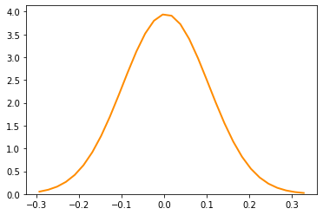
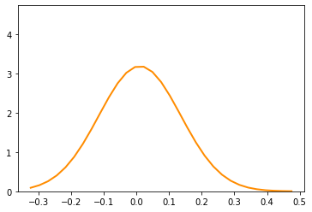
BASIC STATISTICAL CHARACTERISTICS: SYMMETRY
Symmetry: are data found evenly around the center, or are they positively skewed (long right tail) or negatively skewed (long left tail)?
Skewness coefficient: uses mean + standard deviation; not resistant
Yule-Kendall Index : uses Q1, Q3 + median; actually robust + resistant
~ no skew
~ positive skew

Slide 8
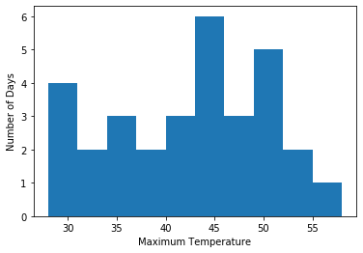
USEFUL VISUALIZATION: HISTOGRAM
Is: a visualization representation of the frequency distribution of a dataset
Give a sense of: location, spread, symmetry, type of distribution
Caveat: bin width choice

Slide 9
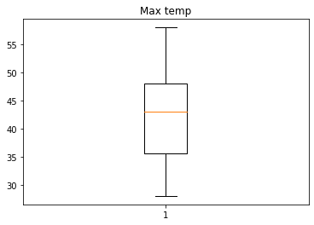
USEFUL VISUALIZATION: BOX & WHISKER PLOT
Is: a graphical, five-number summary of a dataset
Gives a sense of: quartiles, IQR
Caveat: the whisker doesn’t always give you the breakdown of outliers
Tip: comparing box-and-whisker plots side-by-side can be really helpful
maximum
Q3
median
Q1
minimum

Slide 10
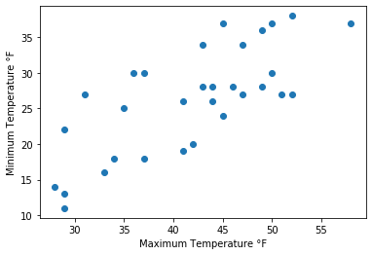
USEFUL VISUALIZATION: SCATTER PLOT
Is: a graph of plotted points for two variables
Give a sense of: the relationship between two variables
Tip: a matrix of scatterplots can be helpful!

